Slide 1
Viewpoint-oriented requirements methods
Presented by: Kamulegeya Grace

Slide 2
Objectives
To explain the notion of viewpoints in RE
To explain the notion of viewpoints in structured analysis
To introduce emerging viewpoint approaches in RE

Slide 3
Viewpoints-oriented requirements engineering
RE involves the capture, analysis and resolution of many ideas, perspectives and relationships at varying levels of detail
Methods based on rigid global schemes do not adequately address the diversity of issues presented by RE problems
Methods based on the notion of viewpoints evolved to address the problem

Slide 4
Example
Consider the requirements for a system to be installed on a train which will automatically bring the train to a halt when it wrongly goes through a danger signal
Some examples of viewpoints for this system and the requirements they encapsulate might be:
  Driver Requirements from the train driver on the system
  Trackside equipment Requirements from trackside equipment which must interface with the system to be installed
  Safety engineer Safety requirements for the system
  Existing on-board systems Compatibility requirements
  Braking characteristics Requirements which are derived from the braking characteristics of a train.

Slide 5
Advantages of viewpoint-oriented approaches
They explicitly recognise the diversity of sources of requirements
They provide a mechanism for organising and structuring this diverse information
They imparts a sense of thoroughness (completeness)
They provide a means for requirements sources or stakeholders to identify and check their contribution to the requirements

Slide 6
SADT viewpoints
Structured analysis and design technique (SADT) was developed in the late 1970s
The notation consists of a rectangle representing some system activity and a set of four arrows
SADT does not have an explicit notion of viewpoints
  Instead viewpoints are an intuitive extension of its modelling technique
SADT “viewpoints” are sources and sinks of data
In example “viewpoints” are shown in square brackets

Slide 7
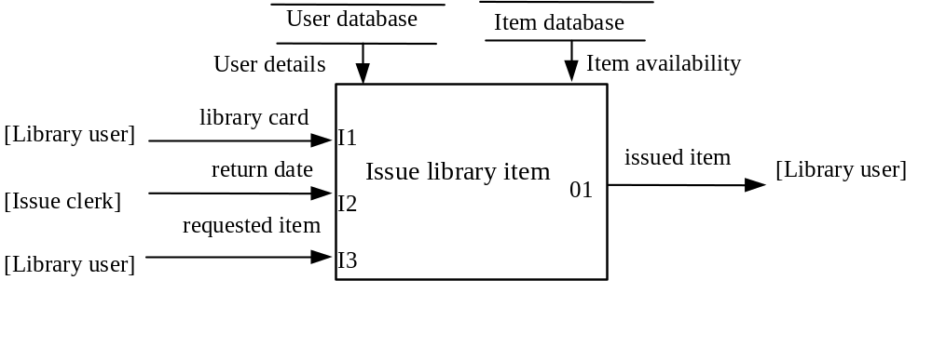
Library example

Slide 8
Controlled requirements expression (CORE)
CORE was developed for the British Aerospace in the late 1970s by System Designers
The CORE method is based on functional decomposition approach
CORE is explicitly based on viewpoints
Viewpoints defines two types of viewpoint:
  Defining viewpoints Sub-processes of the system, viewed in a top-down manner
  Bounding viewpoints Entities that interact indirectly with the intended system

Slide 9
CORE method steps
The CORE method is made up of 7 iterative steps:
  Viewpoint identification
  Viewpoint structuring
  Tabular collection
  Data structuring
  Single viewpoint modelling
  Combined viewpoint modelling
  Constraint analysis

Slide 10
Library example
Step 1-Identifying viewpoints
The first step involves identifying possible viewpoints
From this initial list, defining and bounding viewpoints are identified
There are no hard and fast rules for identifying relevant viewpoints

Slide 11
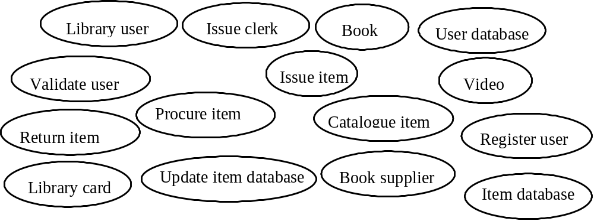
Initial viewpoints

Slide 12
Step 1 - Pruning viewpoints
The last stage in viewpoint identification involves pruning the identified viewpoints into a set of bounding and defining viewpoints as shown in
Each bubble represents the most abstract form of the viewpoint

Slide 13
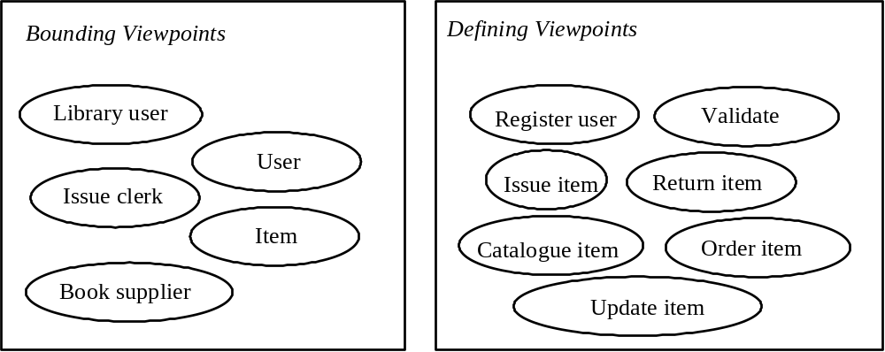
Bounding and defining viewpoints

Slide 14
Step 2 - Viewpoint structuring
Involves iteratively decomposing the ‘target system’ into a hierarchy of functional sub-systems
Structurally bounding viewpoints are placed at the same level as the target system
Each functional subsystem constitutes a viewpoint

Slide 15
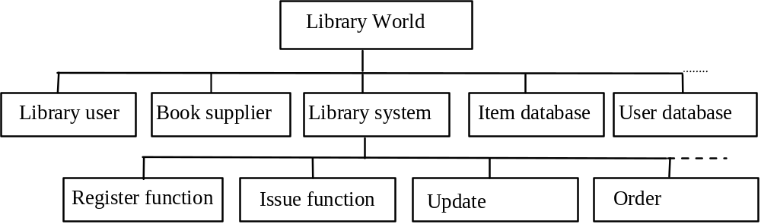
Library system- viewpoint structuring

Slide 16
Step 3 - Tabular collection
A mechanism for gathering information about a viewpoint
Each viewpoint is considered in turn with respect to the action it performs
  Data used for these actions, the output data derived, the source of the data and the destination of the data
Tabular collections serve the purpose of exposing omissions and conflicts in the information flow across viewpoints

Slide 17
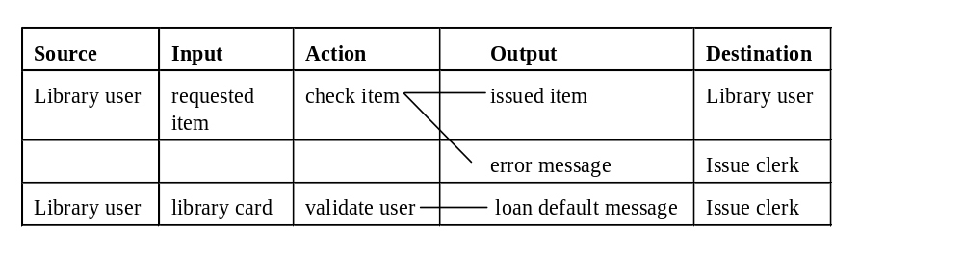
Library system- tabular collection

Slide 18
Steps 4-7
The data structuring step involves decomposing data items into constituent parts and creating a data dictionary
Step 5 and 6 involve modelling viewpoint actions using action diagrams
An action diagram is similar in notation to an SADT diagram
The final step in CORE involves performing constraint analysis on the system as a whole

Slide 19
Problems with CORE
Poorly defined notion of a viewpoint
  Difficult to say what is and what is not a valid viewpoint
Analysis focuses on internal perspectives - defining viewpoints
  Bounding viewpoints not analysed beyond been seen as sinks and sources of data
Difficult to integrate other requirements methods

Slide 20
Viewpoint-oriented system engineering
Developed at Imperial College, London in the early 1990s
Viewpoint-oriented system engineering is a framework for integrating development methods
Viewpoints used viewpoints to partition and distribute the activities and knowledge of the participants in software development
Viewpoints capture the role and responsibility of a participant at a particular time

Slide 21
Viewpoint template
A Viewpoint can be thought of as a template describing:
  Style or representative scheme what it sees
  Domain
  Specification
  Work plan
  Work record

Slide 22
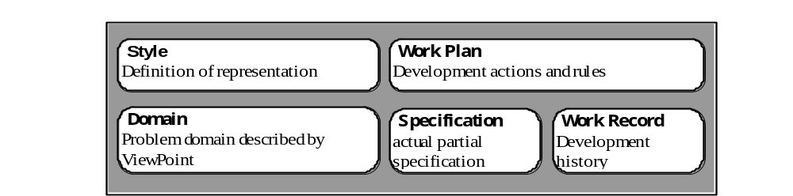
Standard viewpoint template slots

Slide 23
Viewpoint configurations
Viewpoints can be organised into configurations
A configuration may consist of
  Templates with different styles, ‘viewing’ the same partition of the problem domain, or
  Templates with the same style ‘viewing’ different partitions of the problem domain

Slide 24
Library example
Consider a library item presented the user at the issue desk for borrowing, returning or reserving
‘Library world’ can be partitioned into the domains of the issue desk and the library user
Data-flow and state transition schemes are used to model the library item from point of view each domain

Slide 25
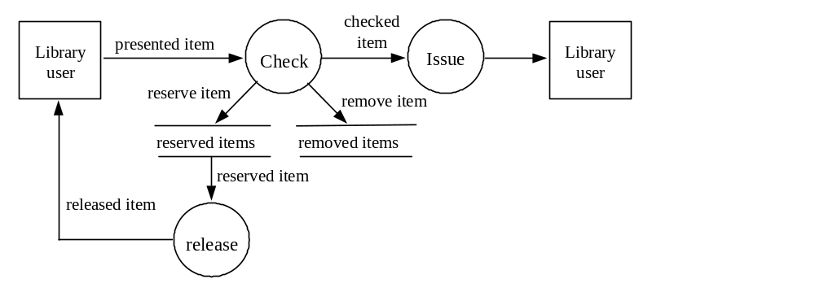
Data-flow model -Issue desk domain

Slide 26
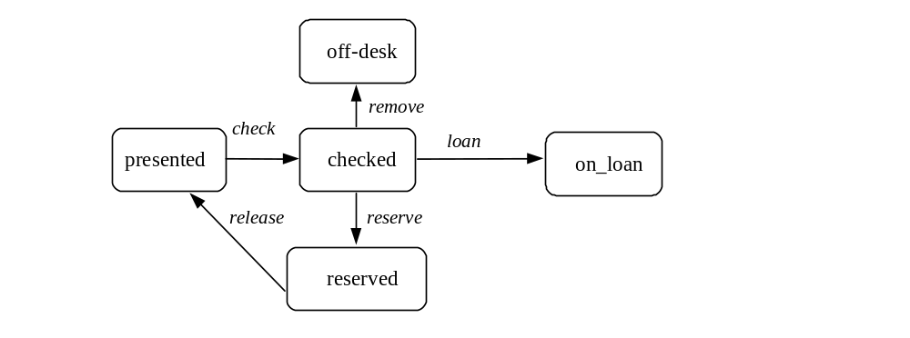
State transition model -Issue Desk Domain

Slide 27
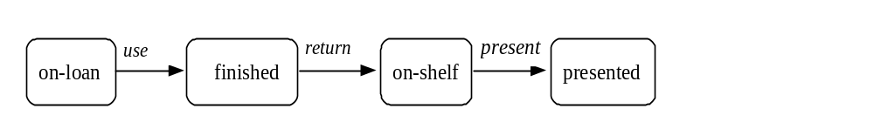
State transition - Library user domain

Slide 28
Conflict resolution
Important to ensure that consistency between different representations of the domains
For similar styles conflicts are resolved by checking for the loss of continuity between the models
For different styles the correspondences between representation schemes need to be identified to facilitate consistency checking

Slide 29
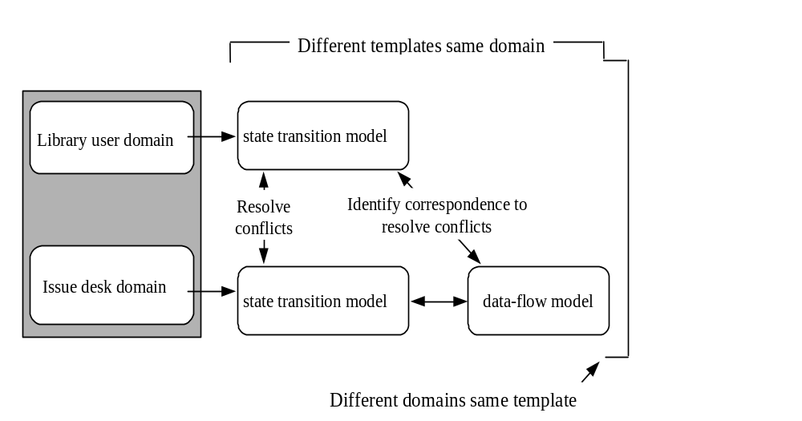
Consistency checking

Slide 30
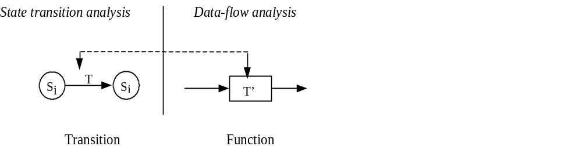
Correspondence between transition and function

Slide 31
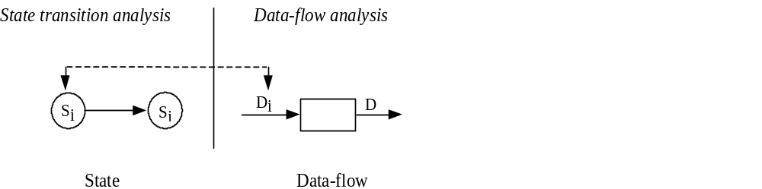
Correspondence between state and data

Slide 32
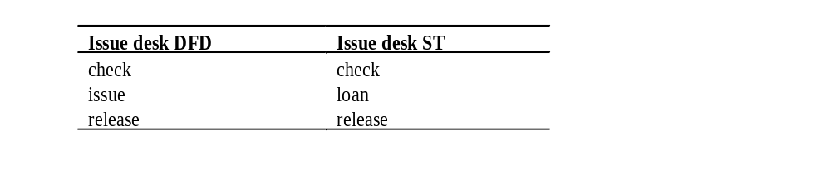
Mapping on different styles same domain

Slide 33
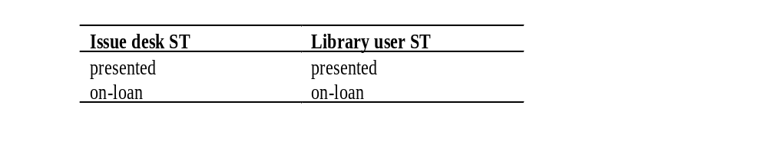
Mapping on different domains same style

Slide 34
Viewpoint-oriented requirements definition
Developed at the University of Lancaster
Mainly intended for specifying interactive systems
Based viewpoints that focus on user issues and organisational concerns
The uses a service oriented model for viewpoints
VORD defines two main types of viewpoints; direct and indirect

Slide 35
Direct and indirect viewpoints
Direct viewpoints
  Interact directly with the intended system
  Correspond directly to clients in that they receive services the system and provide control information
  Include operators/users or other sub-systems interfaced to the system being analysed
Indirect viewpoints
  Do not interact directly with the intended system
  Indirect viewpoints have an ‘interest’ in some or all the services which are delivered by the system
  Generate requirements which constrain the services delivered to direct viewpoints
  Includes organisation, environment, engineering and regulatory viewpoints

Slide 36
Examples of direct and indirect viewpoints
A systems planning viewpoint which is concerned with future delivery of library services (indirect)
A library user viewpoint which is concerned with accessing the system services through the internet (direct)
A trade-union viewpoint which is concerned with the effects of system introduction on staffing levels and library staff duties (indirect)

Slide 37
Viewpoint-oriented requirements validation
Uses viewpoints to support early requirements validation
Objective of the approach is identify and classify problems related to completeness and correctness

Slide 38
Viewpoints, perspectives and views
Viewpoint is defined as a standing position used by an individual when examining a universe of discourse
A perspective is defined as a set of facts observed and modelled according to a particular aspect of reality
A view is defined as an integration of these perspectives
A viewpoint language is used to represent the viewpoints

Slide 39
Method steps
Involves at least two analysts (viewpoints) using VWPL
A view is constructed by describing the problem using three perspectives; data, process and actor perspectives
  Analysts use the is-a and part-of hierarchies to improve their own view
Perspectives and hierarchies are analysed and a ‘list of discrepancies’ and ‘types of discrepancies’ produced
Perspectives are integrated into a view
  Expressed in the process perspective together with the hierarchies
After two views are available compare the different viewpoints for correctness and completeness

Slide 40
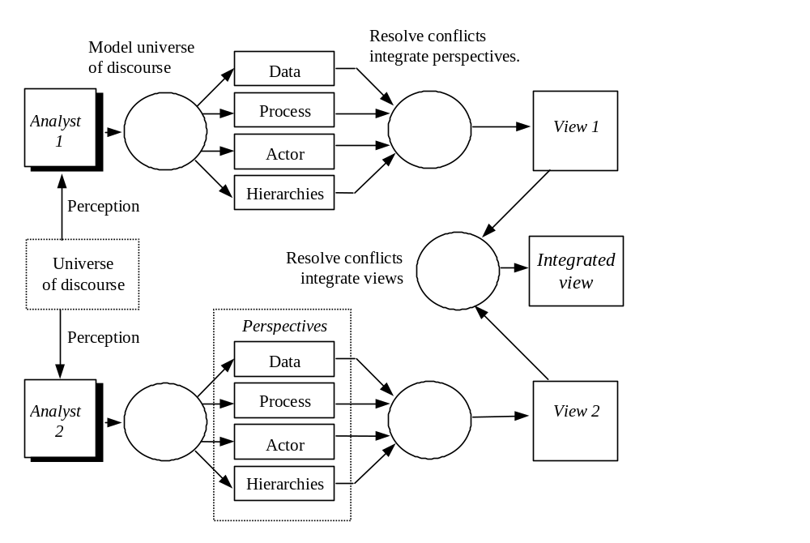
Viewpoint-based requirements validation process

Slide 41
Key points
Requirements engineering is a distributed process involving many participants with different interests
A viewpoint is a collection of information about a system or related problem, environment or domain which is collective from a particular perspective
Structured analysis techniques do not have explicitly defined viewpoints

